Slide 1
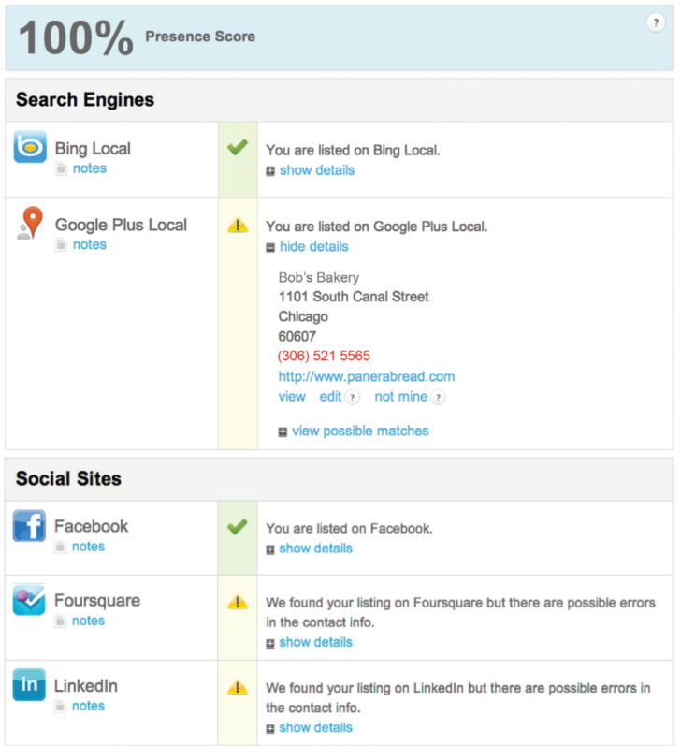
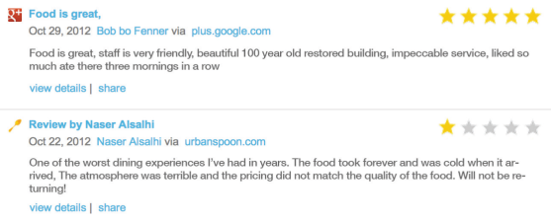
REPUTATION MANAGEMENT
Build your company’s footprint with verified, accurate listings
Your company’s online reputation includes both what you say about your business, and most importantly, what others say about your business. Today, customers use websites like Yelp, Google, Zomato, Tripadvisor, Citysearch, Twitter, and Facebook to voice their opinions, and this constant chatter directly impacts your company’s sales & profit.
Our Reputation Management program helps you claim, correct, and enhance your business information on the top directory sites so that your business appears cohesive online, thus boosting your organic search results.
Once your listings are claimed and accurate, our Reputation Dashboard will display these directories and their accuracy, as well as your user reviews, mentions, and social activity.
BENEFITS OF REPUTATION MANAGEMENT
Build and enhance your online reputation and grow your digital footprint
Accurate, verified online directory listings
Improved company visibility online
Increase your SEO rankings by building your website’s link profile
Monitor reviews & user generated content
Share content & reviews across social networks
Enhance our customer service by knowing what people say about your company
Monitor competitor’s share of voice online
Utilize our dedicated account manager to stay on top of reviews and mentions
Receive alerts each time a review is posted
Keep track of your progress through monthly status reports

Slide 2
REPUTATION OPTIONS
Build your company’s footprint with verified, accurate listings
REPUTATION INTELLIGENCE W/ DISTRIBUTION
Includes:
Reputation Dashboard setup and training
Your company’s name, address, phone number and website submitted to the 4 major data providers that power online directory information – Neustar, Factual, Acxion and Infogroup.
REPUTATION & SOCIAL MEDIA MANAGEMENT
Includes:
Ongoing management of Facebook, Twitter and Google+
Up to 12 status updates per month
Dedicated Fulfillment manager
Directory Listing claiming, setup and enhancement
Your company’s listing information submitted to 4 major data sources
Ongoing monitoring & responses to social media comments & mentions
Ongoing monitoring & responses to directory listing reviews & comments
Reputation Dashboard setup and training
Recurring monthly touch points, review alerts, and monthly reporting
Custom Quoted
NEW! REVIEW GENERATION TOOLS
Request reviews via customer email lists each month. The email directs recipients to your website with an embedded widget or to a free landing page to review your business. We will send one email blast out each month!
LISTING SOURCES INCLUDE:
411.Com
Bing Local
CitySearch
Angie’s List
MerchantCircle
Superpages
Yellow Book
Yellow Bot
YellowPages
Yelp
OpenTable
Trip Advisor
Zomato
Google+
Facebook
Twitter
Fousquare

