Slide 1
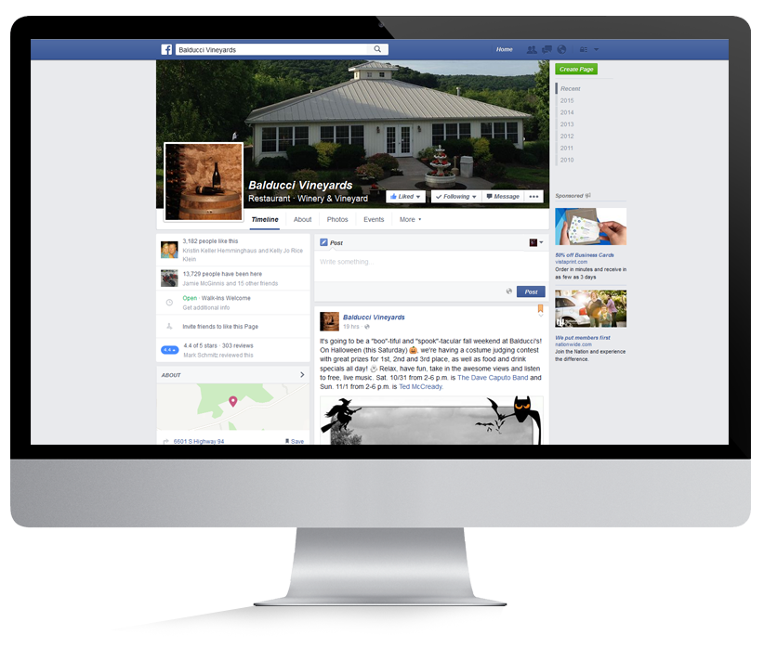
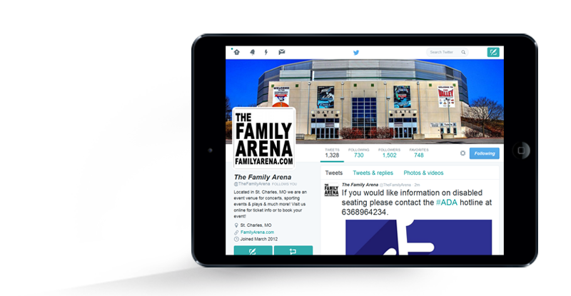
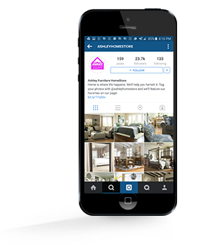
SOCIAL MEDIA MANAGEMENT
Engage with consumers and build relationships
Social media is just like word-of-mouth marketing. By utilizing social media channels such as Facebook, Twitter, Pinterest, etc. our Social Team will strategically develop and manage your social media platforms, helping you increase brand awareness, build relationships, engage with customers, manage targeted social ads, and manage your online reputation.
BENEFITS OF SOCIAL MEDIA MANAGEMENT
Set your business apart from the competition with a professional social media presence
Increase your SEO rankings by building your website’s link profile socially
Direct conversations that are already happening about your brand
Choose the networks that make sense for your company
Increase customer service and engagement on social channels
Build and enhance your online reputation and grow your digital footprint
Utilize our dedicated Social Media account manager to stay on top of new trends and changes
Engage your audience with cleverly written content and imagery

Slide 2
SOCIAL MEDIA OPTIONS
Engage with consumers and build relationships
STANDARD SOCIAL MEDIA
SOCIAL BIZ
Includes:
Facebook, Twitter & Google+
Up to 12 custom written status updates per month
Dedicated Social Media manager
Best practices strategy consultation
Recurring touch points & content review
Profile Setup / Enhancement
Social Management Dashboard
Includes:
Facebook Only
Up to 12 custom written status updates per month
Dedicated Social Media manager
Best practices strategy consultation
Recurring touch points & review
Social Management Dashboard
Up to 2 Custom Facebook Tabs
Quarterly Contests
PREMIUM SOCIAL MEDIA
Includes:
Facebook, Twitter & Google+
Up to 12 custom written status updates per month
Dedicated Social Media manager
Best practices strategy consultation
Recurring monthly touch points & content review
Profile Setup / Enhancement
Engaging Content & Updates
Quarterly Contesting
3 Custom Facebook Application Tabs
SOCIAL NETWORK OPTIONS
Facebook custom application tab ideas include: locations, shop online, email newsletter subscription, twitter feed, pinterest feed, contesting & more!

